Slide 1

Generating report from CSV File using Shell Scripting

Slide 2
Bash Basics
Shell Scripting
Parsing CSV Files

Slide 3

BASH
BASICS

Slide 4

What’s Shell?
An interface between a user and an operating system. We can access shell using a Terminal
e.g. PowerShell (Windows), Bash (Linux)
What’s Bash?
Bash is the most popularly used shell, and is the command line language for most Unix/Linux-based OS

Slide 5

Why use Bash?
Bash is far more flexible than cmd. It enables user to access Unix/Linux commands
How to use Bash in other OS?

Slide 6
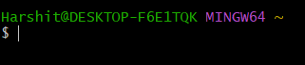
Why use Bash?
Bash is far more flexible than cmd. It enables user to access Unix/Linux commands and software.
Some basic Bash Commands...
How to use Bash in other OS?

Slide 7
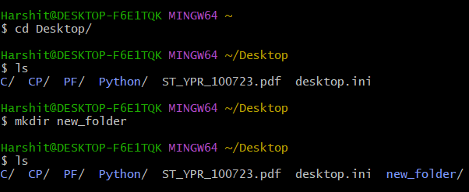
To change directory:
cd path
To list out files & folders in present working directory:
ls
To create a new folder:
mkdir foldername

Slide 8
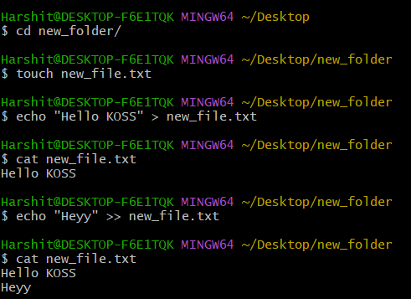
To create new file:
touch filename
To overwrite a text file
echo text > filename
To append to a text file:
echo text >> filename
To read the whole text file:
cat filename

Slide 9
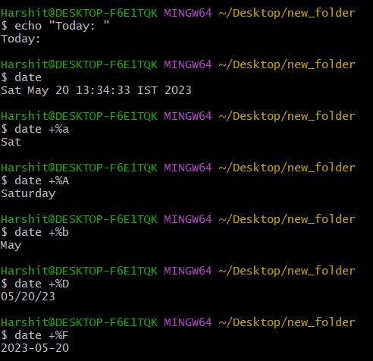
date Command

Slide 10
How to execute multiple commands at once?
date Command

Slide 11
SHELL
SCRIPTING

Slide 12
What?
Shell Scripting is making a program to write a series of commands for the shell to execute
Why?
It combines lengthy and repetitive sequences of commands that can be stored and executed anytime which, reduces programming efforts

Slide 13
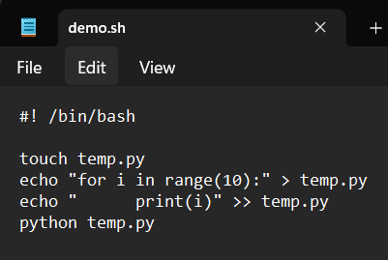
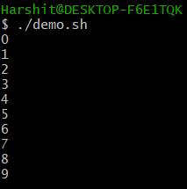
How?
Open your favorite text editor...
Note the extension of file
Run the script in the shell terminal
./filename
Line to be added in the
beginning of every script
Commands to be executed
Commands
executed

Slide 14
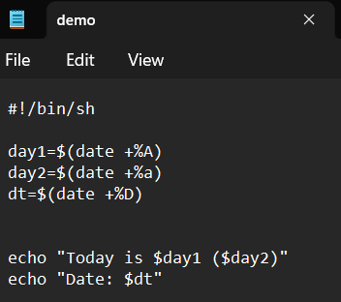
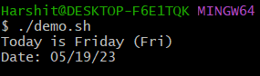
Shell Variables
Declare variables as name=value Note: there must be no space on either side of ‘=’
$ is used to access the value of a variable, expression or a command

Slide 15
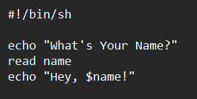
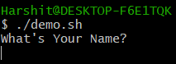
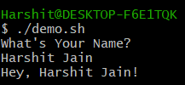
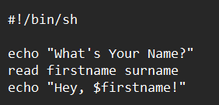
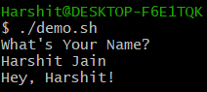
Read Input
The input is split at <space> & <tab> according to no. of variables declared
Take input using command: read variable

Slide 16
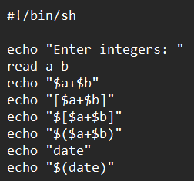
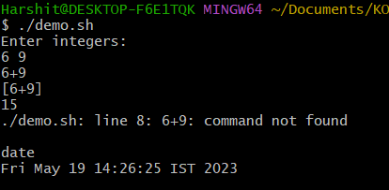
Evaluate Expressions & Commands
To evaluate expressions:
$[expression]
To evaluate commands:
$(command)

Slide 17
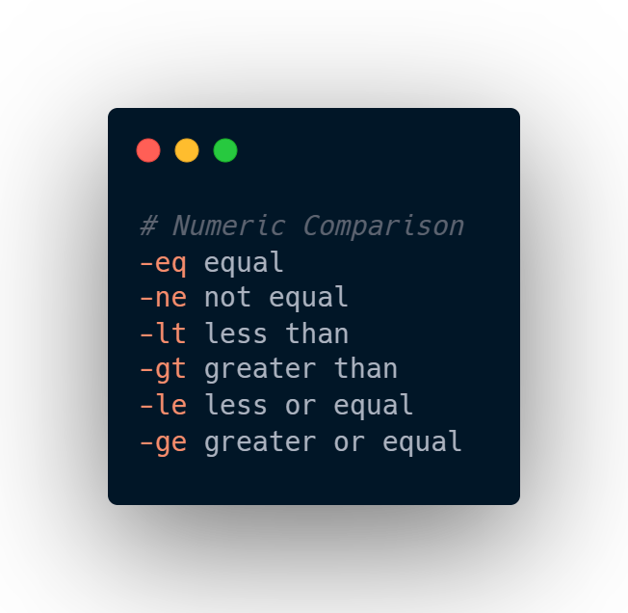
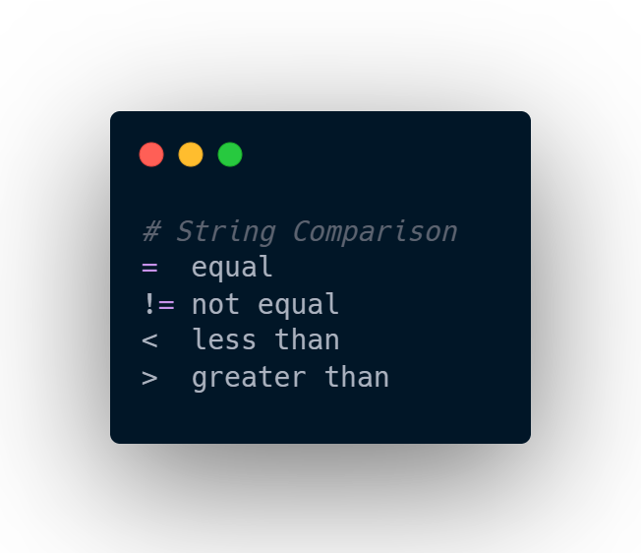
Some Comparison Operators

Slide 18
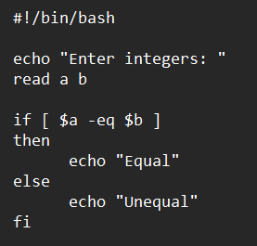
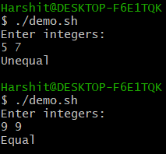
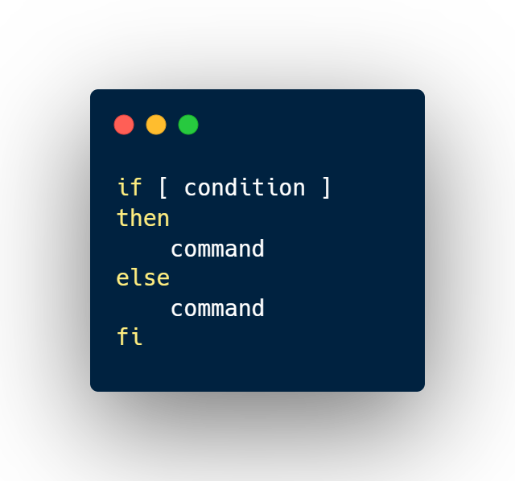
If-Else Statements

Slide 19
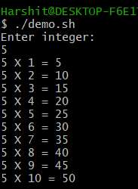
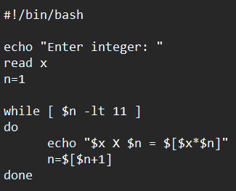
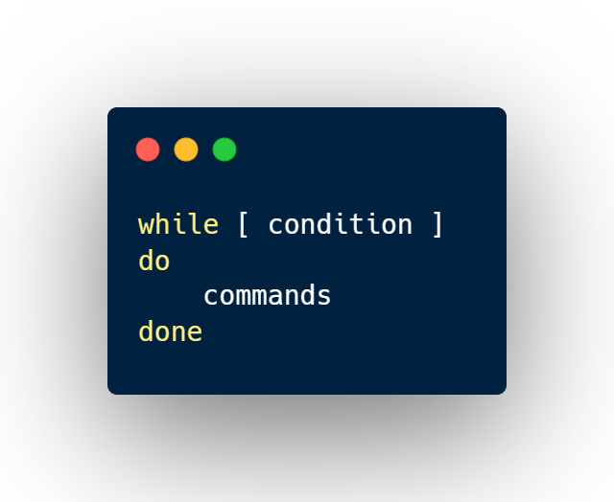
While Loops

Slide 20
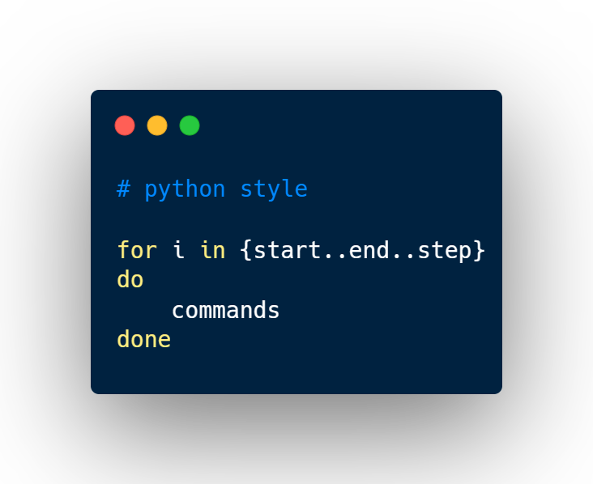
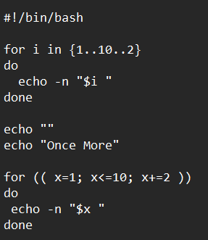
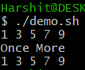
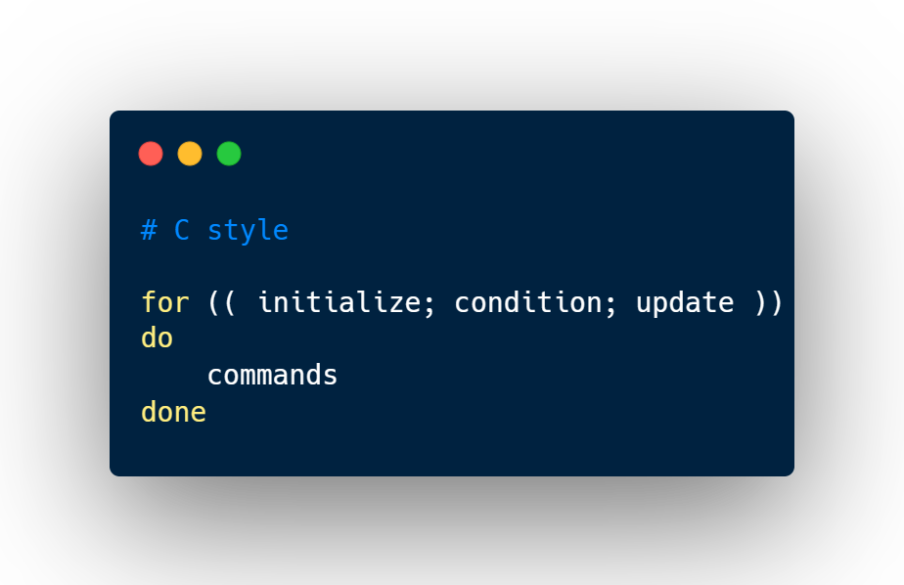
For Loops
flag to print output of next echo in the same line

Slide 21
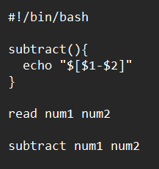
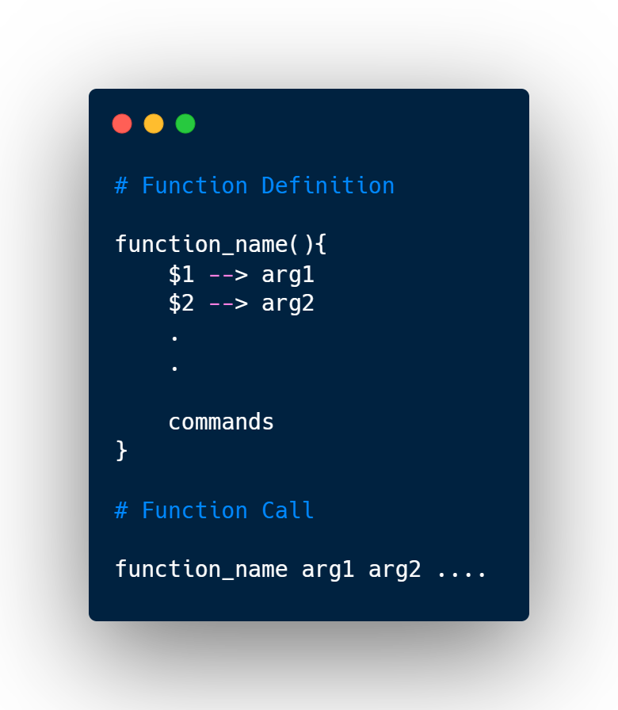
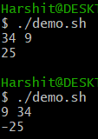
Functions

Slide 22
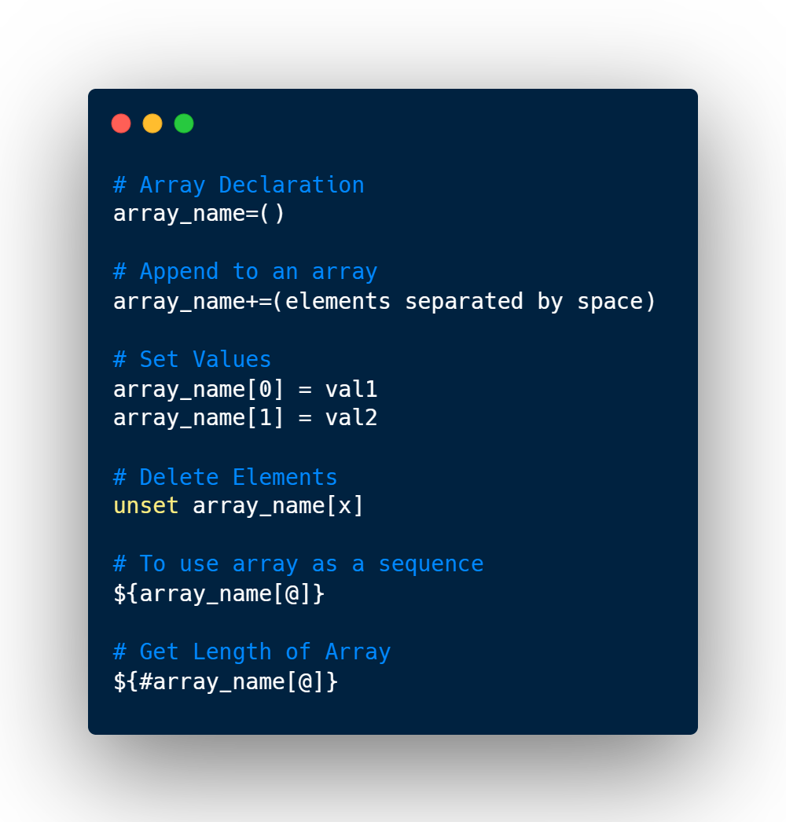
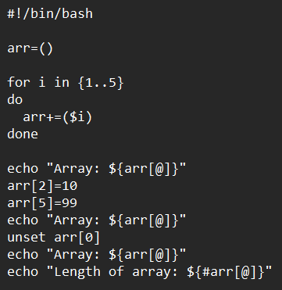
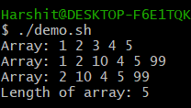
Bash Arrays

Slide 23
Bash Arrays
Utilizing Shell Scripting to read data from CSV files through Bash Terminal...

Slide 24
PARSING
CSV
FILES

Slide 25
What are CSV Files?
Comma Separated Files
Fields are separated by comma (,)
Each record is on a separate line, delimited by line break
Last record may or may not end with line break. (For parsing purposes, it should)

Slide 26
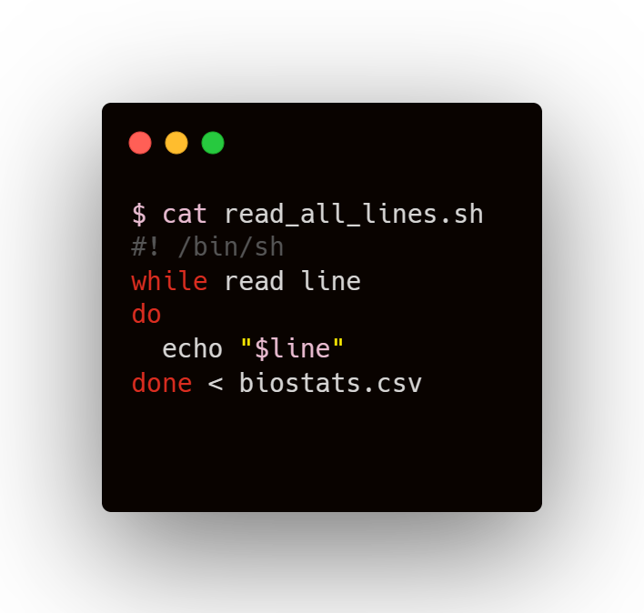
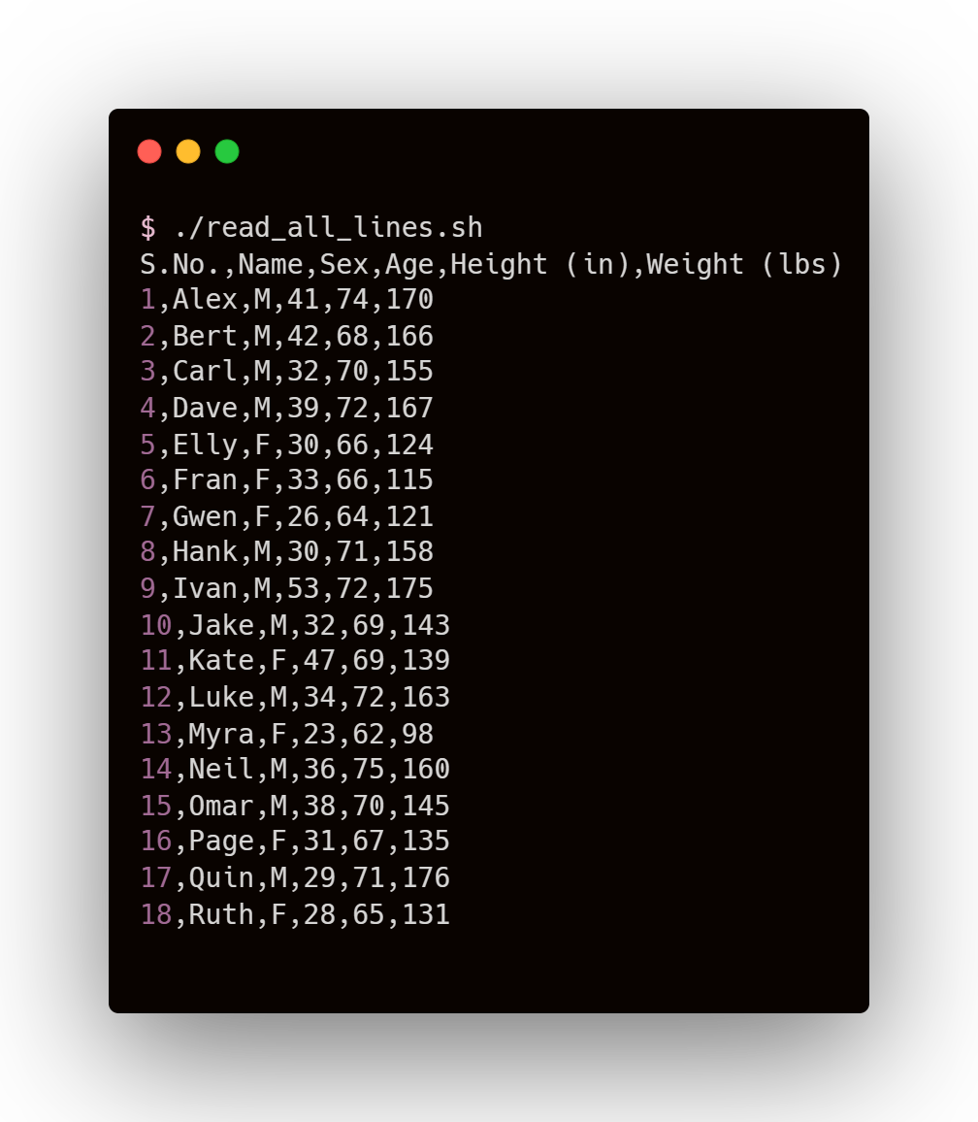
Reading All Lines

Slide 27
Reading All Lines
Input Redirection
Setting the desired file as input for the while-do-done loop

Slide 28
Reading All Lines
Reading from file
A line (ending with newline character) is stored in ‘line’ variable
Input Redirection
Setting the desired file as input for the while-do-done loop

Slide 29
Reading All Lines
COMMANDS
OUTPUT

Slide 30
How to ignore Header?

Slide 31
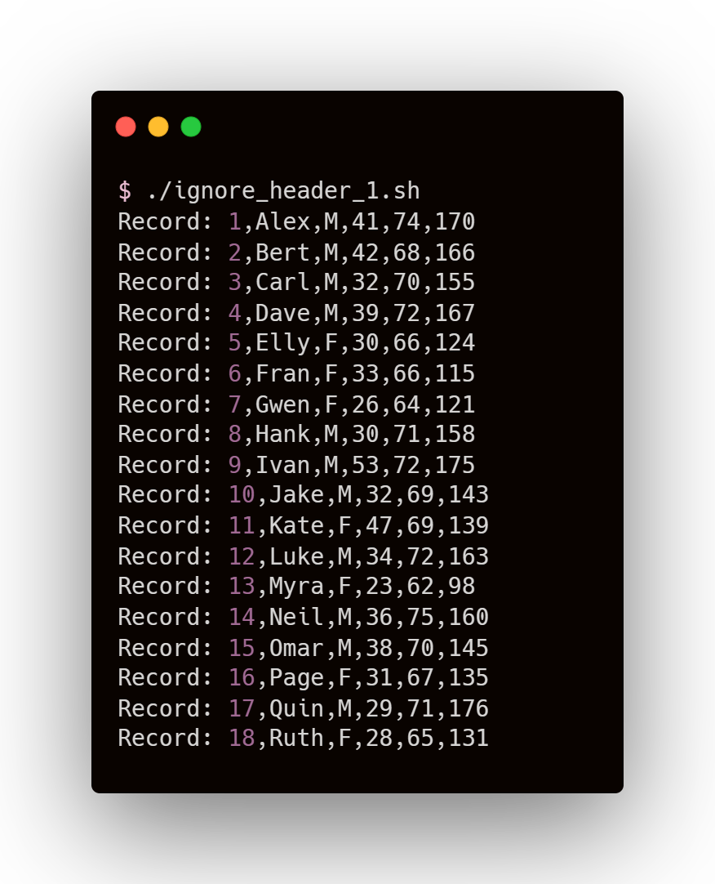
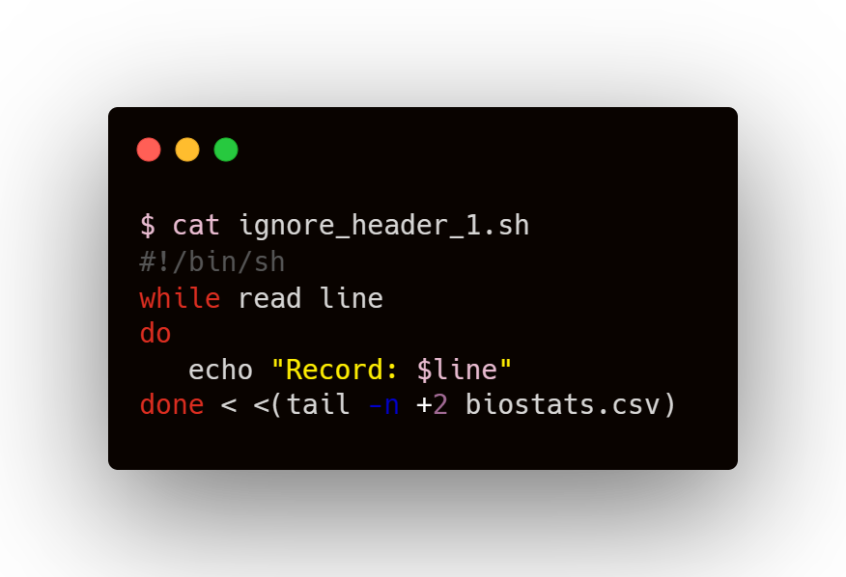
How to ignore Header?

Slide 32
How to ignore Header?
tail Command
tail filename
Returns last 10 lines of file
tail –n x filename
Returns last x lines of file
tail –n +x filename
Returns lines from xth line to end

Slide 33
How to ignore Header?
tail Command
tail filename
Returns last 10 lines of file
tail –n x filename
Returns last x lines of file
tail –n +x filename
Returns lines from xth line to end
Process Substitution
<(command) allows the command to appear as a file

Slide 34
How to ignore Header?
tail Command
tail filename
Returns last 10 lines of file
tail –n x filename
Returns last x lines of file
tail –n +x filename
Returns lines from xth line to end
No Space for process substitution
Space for redirection
Process Substitution
<(command) allows the command to appear as a file

Slide 35
How to ignore Header?
COMMANDS
OUTPUT

Slide 36
How to ignore Header?
Since we can skip reading header (the first row of file), there must be a similar way to read specific rows of the data...

Slide 37
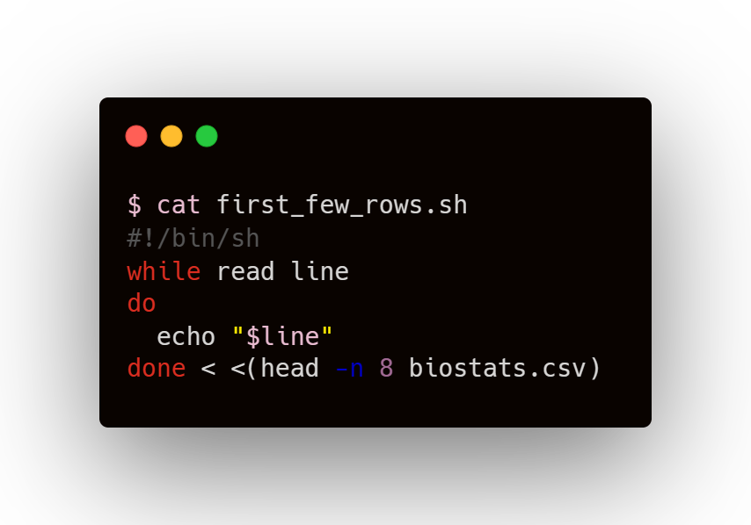
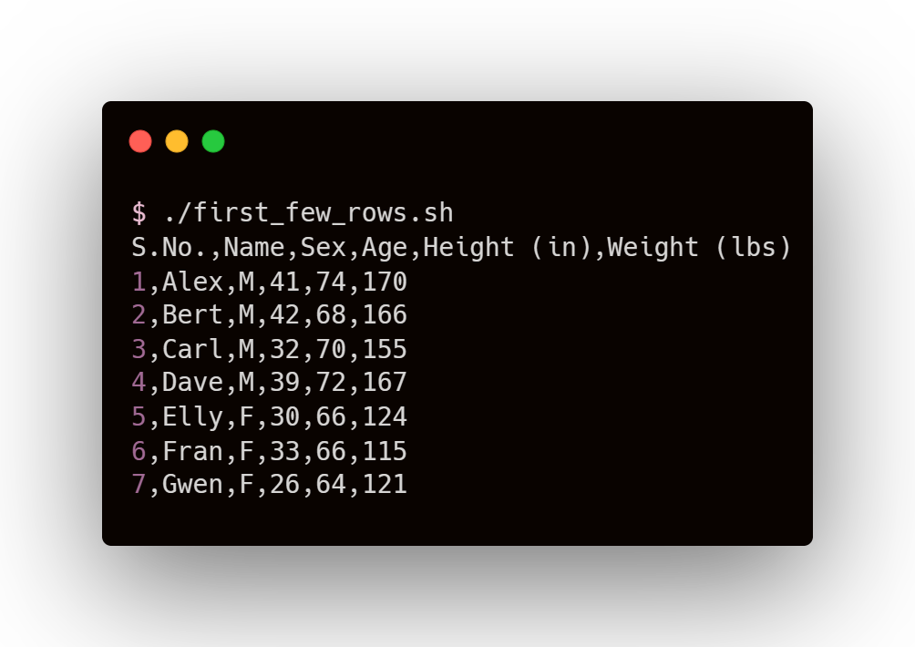
Read first few rows

Slide 38
Read first few rows
head Command
head filename
Returns first 10 lines of file
head –n x filename
Returns first x lines of file

Slide 39
Read first few rows
COMMANDS
OUTPUT

Slide 40
Read first few rows
We can use head command along with tail command to read rows in a specific range

Slide 41
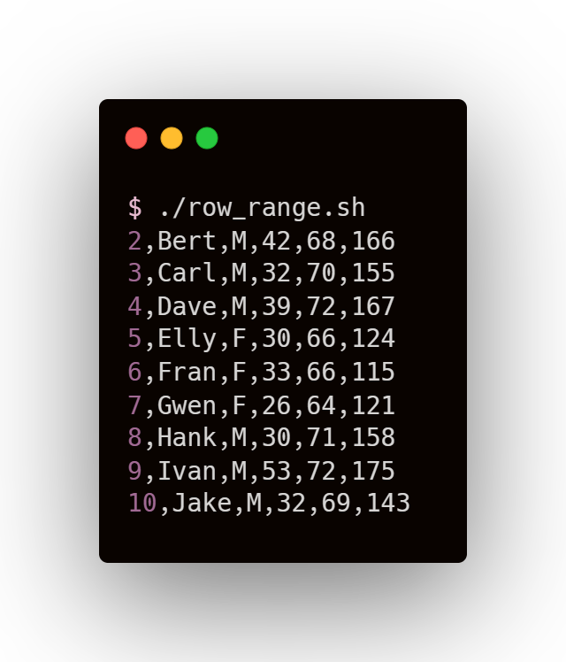
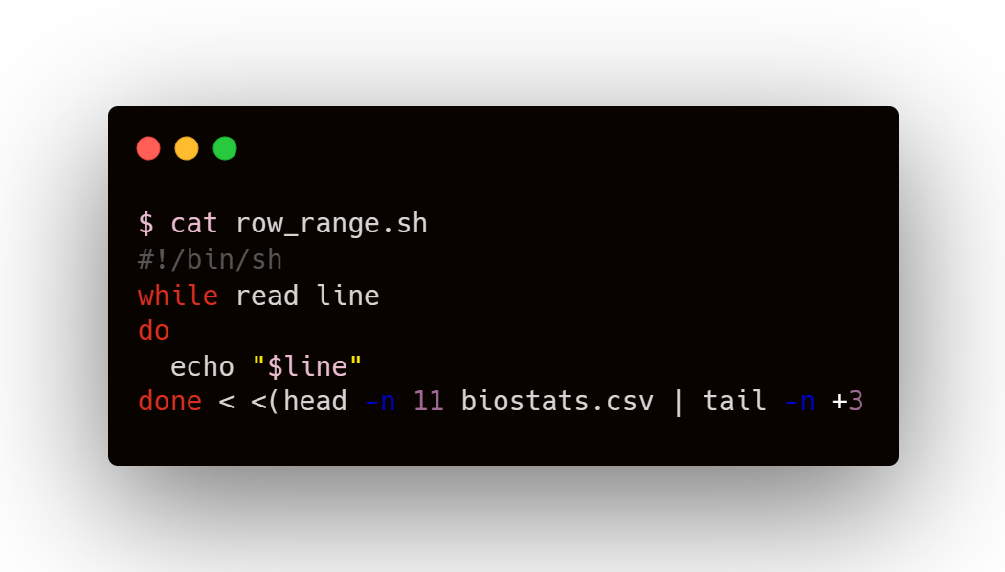
Read rows in a specific range

Slide 42
Read rows in a specific range
Piping
Output of first application (left of pipe ‘|’) becomes the input of second application (right of pipe)

Slide 43
Read rows in a specific range
Piping
Output of first application (left of pipe ‘|’) becomes the input of second application (right of pipe)
File
First x lines of file
yth to xth lines of file
head –n x
tail –n +y

Slide 44
Read rows in a specific range
COMMANDS
OUTPUT

Slide 45
Read rows in a specific range
To read columns, we make use of the fact that CSV files contain Comma Separated Values

Slide 46
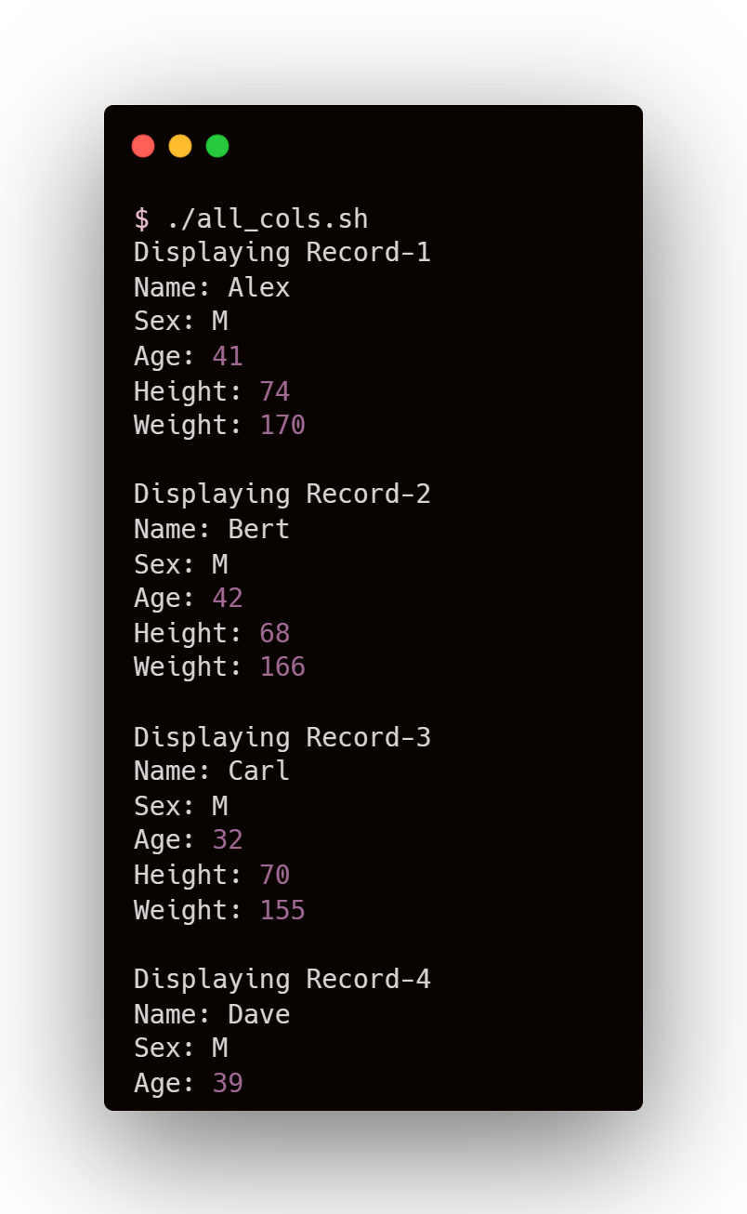
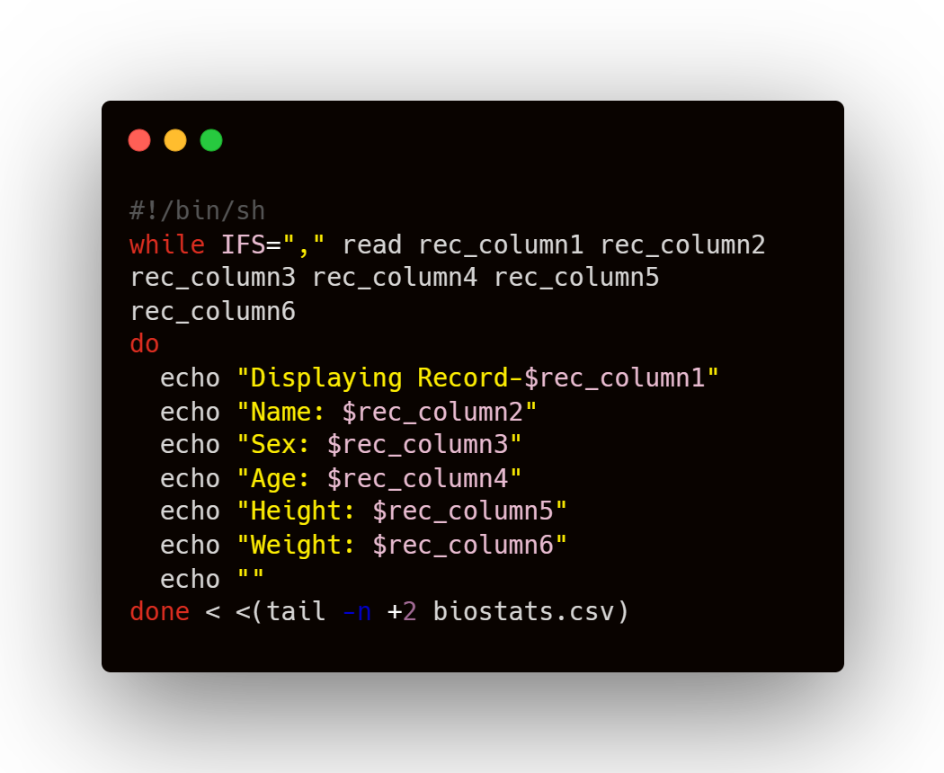
Read all columns

Slide 47
Read all columns
Internal Field Separator
Using IFS, line is divided into fields (tokens) and each token is assigned to a separate variable
For CSV, setting IFS=‘,’ is an obvious choice. In a line, each token is value from different column

Slide 48
Read all columns
COMMANDS
OUTPUT

Slide 49
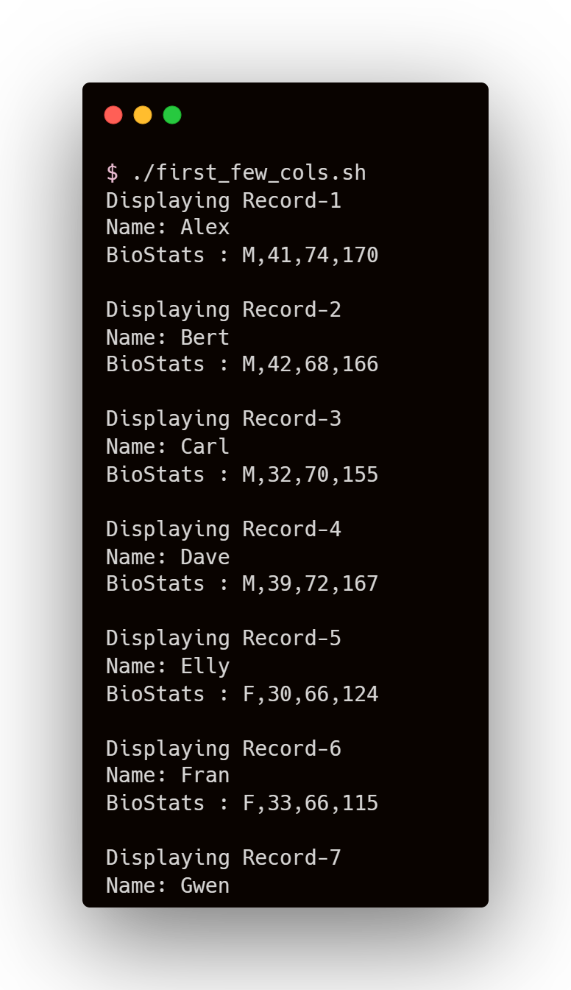
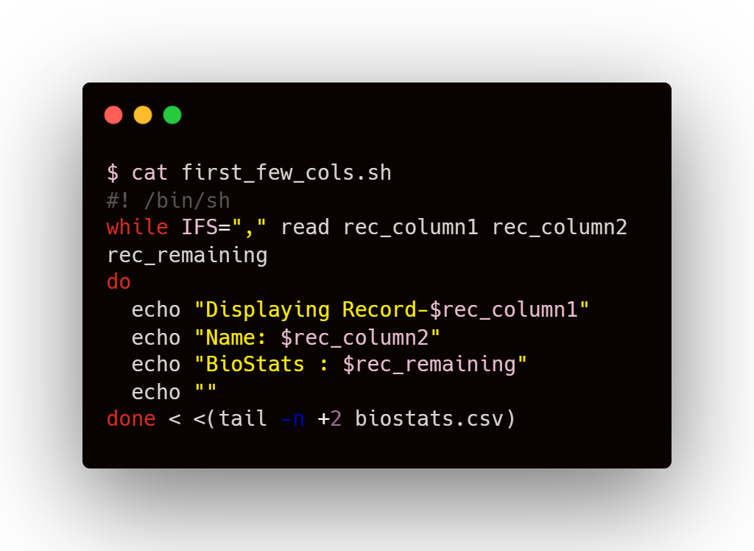
Read first few columns

Slide 50
Read first few columns
As number of variables defined is less than the number of columns, all remaining fields are assigned to the last variable
In fact, if there are (x) variables, the line is split (x-1) times, giving (x) tokens

Slide 51
Read first few columns
COMMANDS
OUTPUT

Slide 52
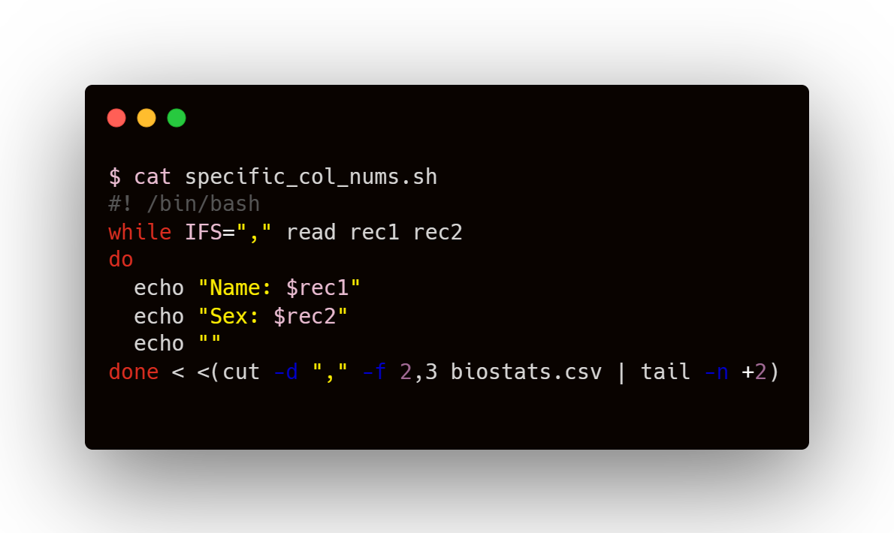
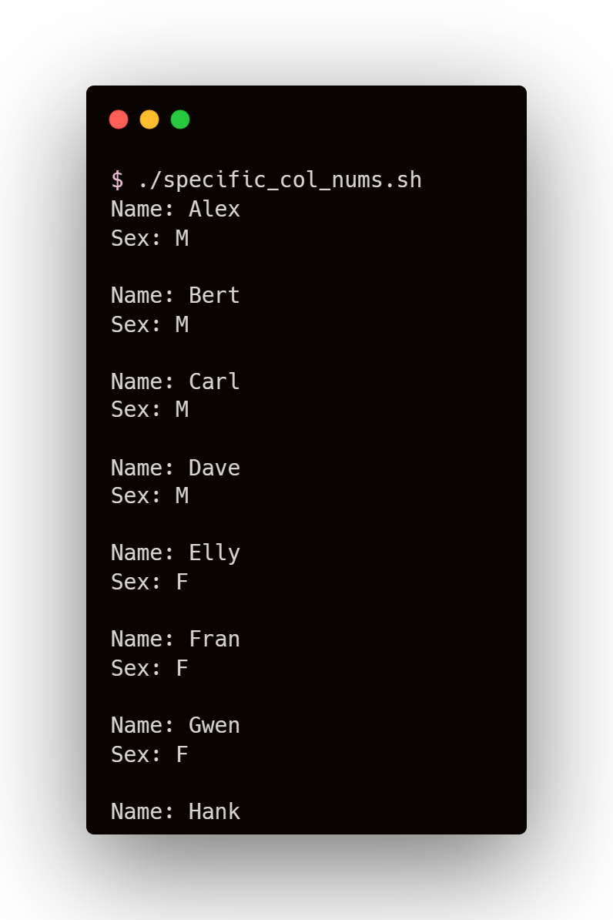
Read by specific column numbers

Slide 53
Read by specific column numbers
Cut command
for cutting sections from each line of file
column no’s
setting delimiter (character at which cutting is desired)
To slice data field by field

Slide 54
Read by specific column numbers
COMMANDS
OUTPUT

Slide 55
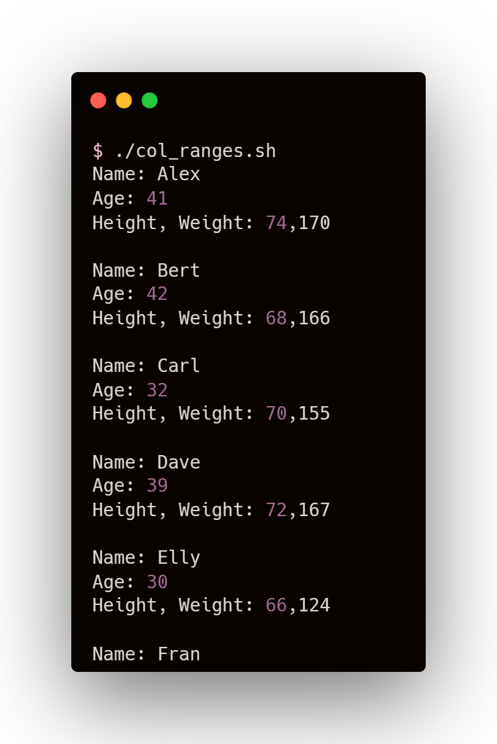
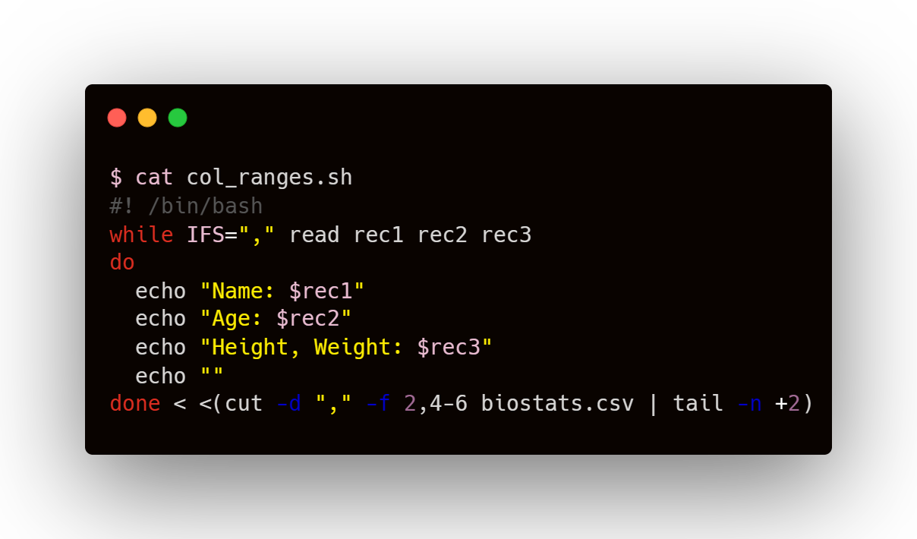
Read columns in a range

Slide 56
Read columns in a range
column numbers and column ranges separated by comma

Slide 57
Read columns in a range
Col 2
Col 4
Col 5
Col 6
rec1 rec2 rec3
column numbers and column ranges separated by comma

Slide 58
Read columns in a range
COMMANDS
OUTPUT

Slide 59
Read columns in a range
Generating a Report from a CSV file using the knowledge of Bash we’ve gathered so far...

Slide 60
USER REPORT
OF A
CSV FILE

Slide 61
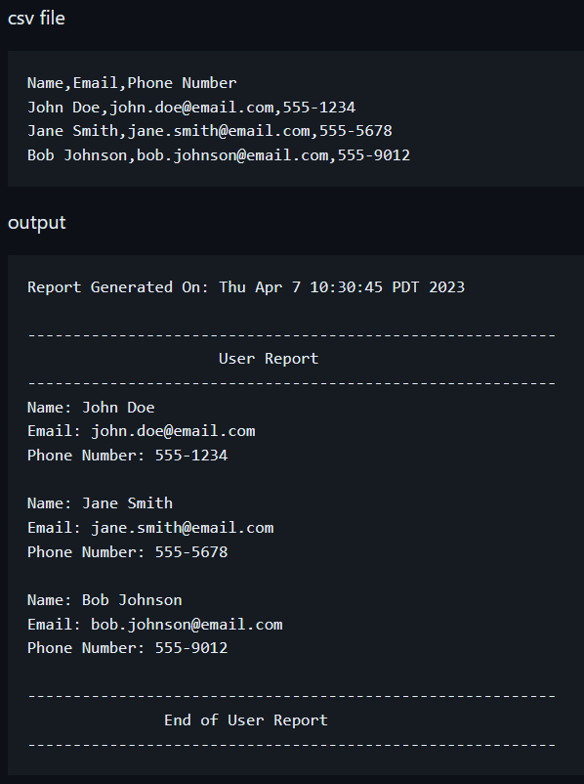
Format of
the Report

Slide 62

1. Storing headers in an array

Slide 63
1. Storing headers in an array
Only the first row of the file is read
“first” variable stores that line

Slide 64
1. Storing headers in an array
No. of columns = 6, so iterating from 0 to 5
Using cut command to get field-wise data of the string stored in “first” variable

Slide 65

1. Storing headers in an array

Slide 66

2. Printing data acc to the format

Slide 67
2. Printing data acc to the format
All lines (except header) are read
“rec” variable stores the line at every iteration

Slide 68
2. Printing data acc to the format
Using cut command to get field-wise value of line stored in “rec” variable
“data” array contains fields of nth line at nth iteration of outer while loop

Slide 69

2. Printing data acc to the format

Slide 70


3. Decorating

Slide 71

4. Center Justifying Text

Slide 72
4. Center Justifying Text
(60-len)/2
len
TEXT AT CENTER
60

Slide 73

4. Center Justifying Text

Slide 74

5. Dating the Report

Slide 75

Generated User Report

Slide 76
Thank You

